Slide 1
Chapter 15:
Genetics can be used to understand the traits of individuals and families

Slide 2
15.1 Mendelian inheritance
Mendelian inheritance
The first clear explanation of patterns of inheritance was provided by an Austrian monk, Gregor Mendel, in 1865.
After 10 years of research into the reproductive behaviour of pea plants, Mendel put forward two principles relating to inheritance:
The various hereditary characteristics were controlled by factors (now called genes) that occurred in pairs.
During the formation of the gametes (in humans, the eggs and the sperm), the pairs of factors separate. Each gamete receives only one set of factors, or genes, with the other set going to another gamete. Gametes unite at fertilisation, allowing different combinations of genes to come together.

Slide 3
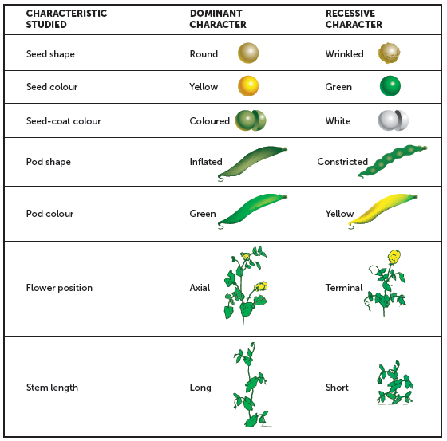
15.1 Mendelian inheritance
Mendel’s experiments
Mendel conducted breeding experiments with the edible garden pea, Pisum sativum. He studied seven pairs of contrasting characteristics in which the alternatives were easily identifiable.

Slide 4
15.1 Mendelian inheritance
Before beginning an experiment, Mendel made sure his plants were pure-breeding for the characteristic he wished to study. He then crossed, or interbred, plants with contrasting traits. For example, plants pure-breeding for yellow-coloured seeds were crossed with plants pure-breeding for green seeds. He found that the offspring (or progeny) resembled only one of the parents. In the example given, the offspring were all plants that produced yellow seeds.
These offspring are referred to as hybrids because they have genetic information for green seed colour as well as genetic information for yellow seed colour, even though they are all yellow. Thus, only one of the pair of contrasting characteristics appeared in the offspring. Mendel referred to the characteristic shown by the hybrid as the dominant trait because it masked the appearance of the other characteristic, which he called the recessive trait.

Slide 5

15.1 Mendelian inheritance
When Mendel allowed the hybrid plants to self-pollinate, a second generation of plants was produced. In this generation the characteristics reappeared in the ratio of about three with the dominant trait for every one with the recessive trait (3:1). From these results, Mendel concluded that the hereditary factors, or genes, were unchanged as they passed from one generation to the next. He further reasoned that each pea plant had two hereditary factors for each characteristic under study.
During the formation of gametes, these factors are separated (or, as Mendel called it, segregated), with each gamete receiving only one factor, or gene, for each trait. This is known as the principle of segregation. As offspring are formed by the union of a male and a female gamete, each offspring receives one gene for each characteristic from each parent.

Slide 6
15.1 Mendelian inheritance
Genotypes and phenotypes
A cross is the mating of two organisms. In a monohybrid cross, only one pair of contrasting characteristics is studied.
Genes for a particular characteristic are represented by two letters, one for the gene that originated from the female parent and one for the gene that originated from the male parent. If the gene is a dominant one, it is shown as a capital letter; if it is a recessive one, a lower-case letter is used.
The phenotype is the physical appearance of a trait as determined by the genotype, the combination of alleles. If the alleles are the same, the genotype is homozygous; if the alleles are different, the genotype is heterozygous.
Offspring are referred to as the first filial generation, denoted by the symbol F₁. If the first filial generation is self-pollinated, a second set of offspring is produced. This is the second filial generation, or F₂.

Slide 7
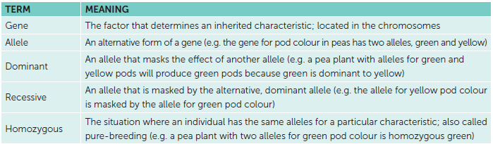
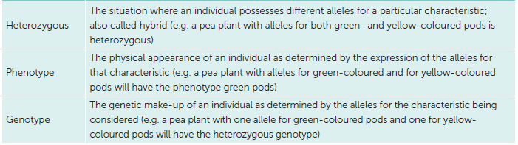
15.1 Mendelian inheritance
Terms relating to Mendelian genetics

Slide 8
15.2 Modelling inheritance
Punnett squares
A Punnett square can be used to model a cross and, therefore, to calculate the probability of genotypes and phenotypes of offspring.
In a Punnett square for a monohybrid cross:
Draw a square with two columns and two rows.
Write the alleles for one parent above the columns – one allele above each column.
Write the alleles for the other parent to the left of the rows – one allele for each row.
For each box, write the combination of alleles for that row and column. Each box represents a possible genotype for the offspring.
Calculate the probability of each genotype and, hence, phenotype.

Slide 9
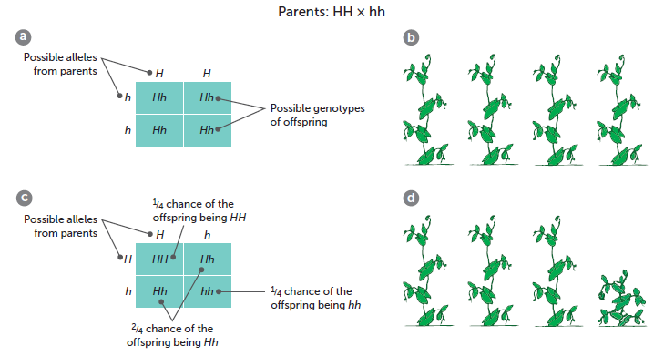
15.2 Modelling inheritance
a Punnett square for a cross between parents with HH and hh genotypes. There is a 100% chance
of the offspring being Hh; b F₁ genotype are all Hh and, therefore, long-stemmed plants; c Punnett square for the F₂ generation – a cross between Hh and Hh. The probabilities of genotypes for the offspring are ¼ HH, 2/4 Hh and ¼ hh; d F₂ phenotypes are 3/4 long-stemmed plants (due to ¼ HH and 2/4 Hh) and ¼ short-stemmed plants (due to ¼ hh)

Slide 10
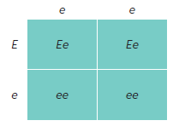
15.2 Modelling inheritance
The principles of Mendelian inheritance and Punnett squares can also be applied to human traits. For example, long eyelashes are dominant over short eyelashes. If a mother with long eyelashes who is known to be heterozygous and a father with short eyelashes are expecting a child, we can use a Punnett square to predict the possible eyelash length of the offspring.
The F₁ have a 50% chance of having long eyelashes and a 50% chance of having short eyelashes

Slide 11
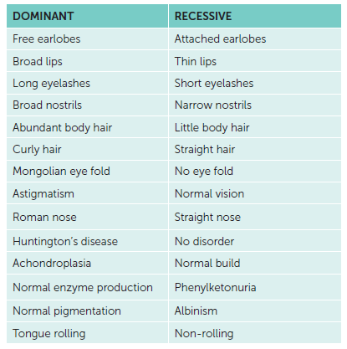
15.2 Modelling inheritance
Some inherited traits in humans

Slide 12
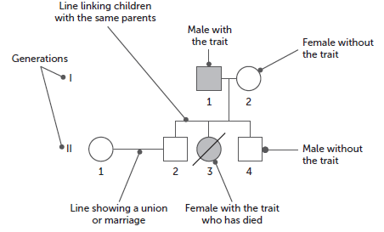
15.2 Modelling inheritance
Pedigrees
A pedigree, or family tree, is used to look at the phenotypes that have been produced in a family.
A number of conventional symbols are used in the construction of such pedigrees. Some of these are shown below.
A pedigree for two generations of a family

Slide 13
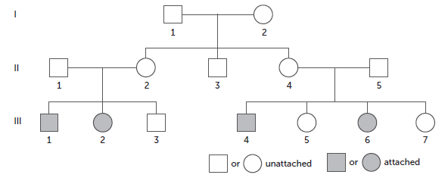
15.2 Modelling inheritance
A human characteristic that can be traced through a family is whether the earlobes are attached or free. Generally speaking, those with free earlobes carry a dominant allele F, and may be of two genotypes: FF or Ff. Attached earlobes are a recessive trait so have the genotype ff.
This pedigree shows thee generations of a family. Those with free earlobes are shown as open symbols; those with attached earlobes are shaded.
Pedigree for a family with attached earlobes appearing in the third generation

Slide 14
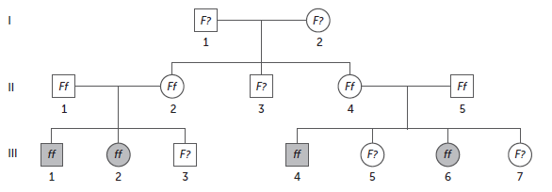
15.2 Modelling inheritance
All the individuals shown shaded must be homozygous recessive (ff), whereas the parents in the second generation (II1, II2, II4 and II5) must all be heterozygous (Ff) as they have the dominant trait, but pass on a recessive allele. Apart from knowing that all other individuals have at least one F allele, it is difficult to determine their exact genotypes. At least one of the original parents must have been heterozygous, to produce children who were heterozygous; however, without more information, we do not know which parent it is. This pedigree summarises what we are able to determine from the information we have.
Genotypes for a family with attached earlobes appearing in the third generation

Slide 15
15.3 Autosomal inheritance of single-gene disorders
Single-gene disorders are disorders caused by the inheritance of a single defective gene.
The pattern of inheritance of single-gene disorders follows the basic laws of heredity already described. However, the severity of the disorder is often variable and difficult to predict.
Humans have 46 chromosomes in all cells except gametes. These are composed of 23 pairs; 22 pairs are autosomal chromosome and 1 pair are sex chromosomes. Autosomal inheritance relates to traits, including disorders, that are inherited on the autosomal chromosomes.

Slide 16
15.3 Autosomal inheritance of single-gene disorders
Dominant, autosomal inheritance of single-gene disorders
Dominant alleles that cause severe defects in people are rarely passed on, because people with such alleles frequently die before they have the opportunity to reproduce.
Examples of genetic disorders caused by dominant alleles on the autosomal chromosomes include:
Achondroplasia
Facioscapulohumeral muscular dystrophy
Huntington’s disease
Neurofibromatosis.

Slide 17
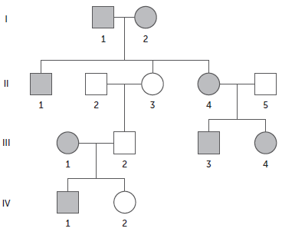
15.3 Autosomal inheritance of single-gene disorders
Huntington’s disease
Huntington’s disease is a single-gene disorder caused by a dominant allele. Symptoms of the disease are often not present until after the individual has had children (symptoms usually appear after 40), and so the dominant allele may be passed without the parents being aware of the possibility.
Genetic screening is now available for people with a parent who either has Huntington’s disease or died from it. Blood from participants and their close relatives is collected and analysed for the presence of three established gene markers. These tests establish an individual’s risk of developing the condition. The condition is incurable, but those people can then make decisions about whether or not to have children.
Pedigree of four generations of a family with a history of Huntington’s disease

Slide 18
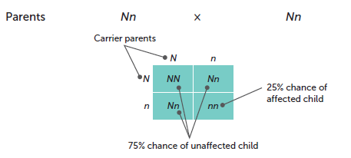
15.3 Autosomal inheritance of single-gene disorders
Recessive, autosomal inheritance of single-gene disorders
A person who has a heterozygous genotyope has a recessive allele but does not show the recessive phenotype. They are known as a carrier for that characteristic. If both parents are carriers, there is a 25% chance that a child receives one defective allele from each parent. This results in the child being homozygous for the recessive allele and, therefore, being affected by the condition. If N is the normal allele and n the allele that causes an abnormality, this can be shown as illustrated in the Punnett square below.
The incidence in the population of severe recessive disorders that are not linked to a sex chromosome is low, because it is unlikely that a carrier from one family will mate with another carrier of the same recessive condition.

Slide 19
15.3 Autosomal inheritance of single-gene disorders
Phenylketonuria
Phenylketonuria is a recessive, single-gene disorder that produces serious abnormalities. The gene concerned controls the production of an enzyme called phenylalanine hydroxylase. This enzyme converts the amino acid phenylalanine to tyrosine. If this enzyme is not present, then phenylalanine will accumulate in the bloodstream and become toxic. The toxicity results in damage to the growing brain and a failure to produce normal skin pigmentation.
Phenylalanine is classed as an essential amino acid and so must be present in the diet. Enough of this amino acid must be present so that a child may grow. For those individuals born homozygous recessive for PKU, excessive amounts of phenylalanine in the diet can be dangerous.
The disease can be identified almost immediately after birth. A blood sample is usually taken by pricking the baby’s heel within two to three days after birth. Special diets restricting the intake of phenylalanine and replacing it with substitutes can, if begun early in the child’s life, largely, if not entirely, correct the symptoms.

Slide 20
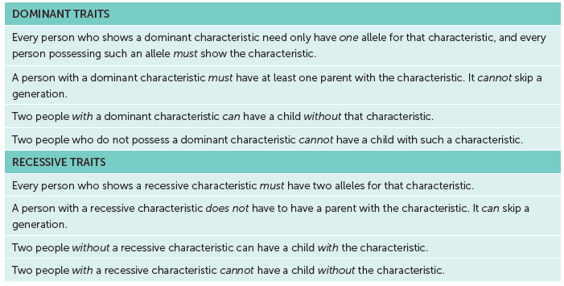
15.3 Autosomal inheritance of single-gene disorders
Using pedigrees for single-gene disorders
These criteria can be used to make predictions about the chances of inheriting a single-gene disorder.

Slide 21
15.4 Sex chromosomes
Sex chromosomes
In women, the 46 chromosomes in the nucleus of each cell are in 23 matched pairs. In men the 46 chromosomes are in only 22 matched pairs, with the 23rd pair consisting of two unmatched chromosomes.
Examination of the 23rd pair of chromosomes in males indicates that one of the pair is similar to the chromosomes of the 23rd pair in females, but the other is much smaller. The large chromosome is known as the X chromosome and the smaller the Y chromosome.
Females have two X chromosomes, and males one X and one Y. These are called sex chromosomes. The 22 pairs of non-sex chromosomes are called autosomes.

Slide 22
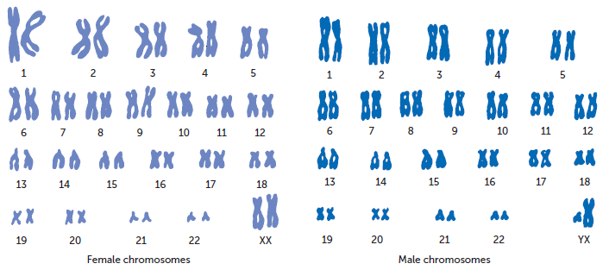
15.4 Sex chromosomes

Slide 23
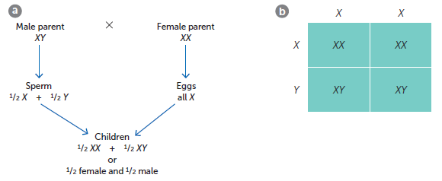
15.4 Sex chromosomes
Sex determination
The sex of a child is determined by the sex chromosomes inherited from the parents. A female child gets an X chromosome from each parent, whereas a male child gets an X chromosome from the mother and a Y chromosome from the father.
a Chromosomal basis for sex determination;
b Punnett square for sex determination

Slide 24
15.4 Sex chromosomes
Sex-linked characteristics
When characteristics located on the X chromosome are studied, it is found that the pattern of inheritance is different in the two sexes. Characteristics that show different patterns in the two sexes are called sex-linked characteristics or X-linked characteristics.
When writing the genotypes of sex-linked characteristics, the sex chromosomes are written as capital letters and the allele is written as superscripts for the X chromosome.
E.g., an X chromosome with a recessive allele would be represented by Xª.
Sex-linked characteristics may be dominant or recessive. The dominant form is much rarer. Two common recessive sex-linked traits are red–green colour blindness and haemophilia.

Slide 25
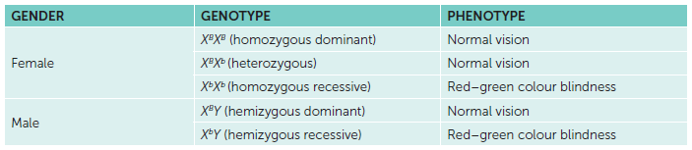
15.4 Sex chromosomes
Red-green colour blindness
The ability to discriminate between the colours red and green is controlled by a gene located in the X chromosome. Individuals who are unable to distinguish between the two colours possess the recessive allele of this gene. The possible genotypes and phenotypes for red–green colour blindness are shown in the table.

Slide 26
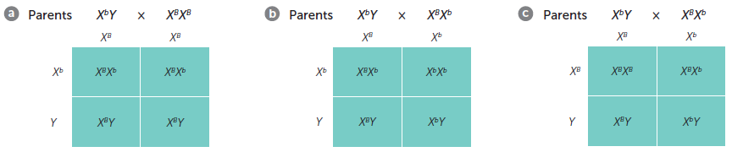
15.4 Sex chromosomes
A recessive allele is able to be masked by the presence of a dominant allele in females. This is not possible in males, so the frequency of colour blindness is higher in males than in females.
The children of a colour-blind man and a woman homozygous for normal vision would all have normal vision. However, the daughters could produce children who are colour blind, since they are carriers for colour blindness as they carry the recessive allele without showing the phenotype. This is shown in Punnett square a.
b Punnett square when the parents are a carrier female and a colour-blind male. There is a 50% chance of a female child being colour blind and a 50% chance of a male child being colour blind;
c Punnett square when the parents are a carrier female and a normal vision male. There is a 0% chance of a female child being colour blind and a 50% chance of a male child being colour blind

Slide 27
15.4 Sex chromosomes
Haemophilia
Haemophilia is a relatively rare disease in which the blood clots slowly or not at all. The defective allele is recessive to that controlling normal clotting of the blood and is carried on the X chromosome. Males, therefore, can be either normal or haemophiliacs, as they have only one X chromosome. Females can be homozygous normal; heterozygous, and therefore carriers of the condition; or haemophiliacs. This last case is extremely rare.
The pattern of inheritance for haemophilia is similar to that for red–green colour blindness. Haemophiliac fathers pass the recessive gene to their daughters. Carrier mothers may pass a defective gene to their sons, who will be haemophiliacs, or to their daughters, who will then also carry the gene.

Slide 28
15.4 Sex chromosomes
Patterns with sex-linked inheritance
Knowledge of sex determination and Mendelian inheritance allows us to understand the patterns that occur in sex-linked inheritance:
A son’s X chromosome must come from his mother, therefore a father cannot pass a sex-linked trait on to a son. This also means that if a mother has a recessive sex-linked trait, any sons will also have the trait.
A father can only give his X chromosome to a daughter. Therefore, if a daughter has a recessive sex-linked trait, then her father must also have it as he cannot be a carrier.
Females may be carriers of a recessive sex-linked trait. If an unaffected mother has an affected child, then she must be a carrier.
Two people without a recessive sex-linked trait can have a son with the trait, but not a daughter.

Slide 29
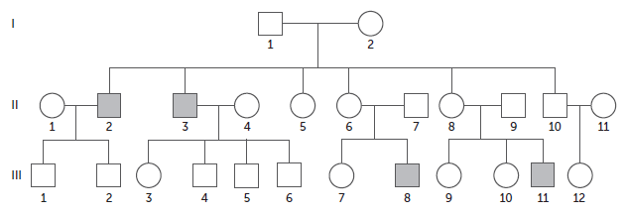
15.4 Sex chromosomes
Pedigree for a recessive sex-linked trait
The following can be inferred from the pedigree:
Affected individuals (II2, II3, III8 and III11) must be X^{h}Y.
All other males are unaffected, and therefore must be XHY.
Mothers of affected individuals must carry the recessive allele, therefore their genotypes must be X^{H}X^{h}.
Any daughters of affected males must have the recessive allele. As they are unaffected, their genotype must be X^{H}X^{h}.
All other females must have a dominant allele. However, it is not possible to know whether they are homozygous dominant (X^{H}X^{H}) or heterozygous (X^{H}X^{h}).

Slide 30
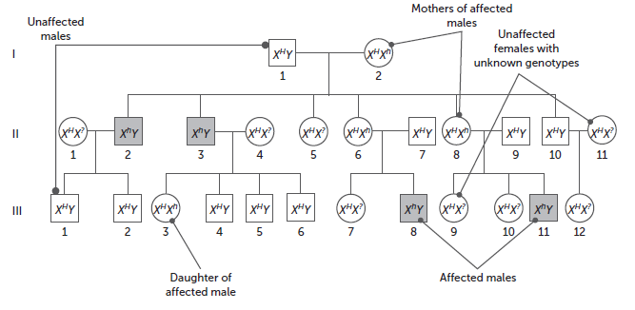
15.4 Sex chromosomes
Pedigree with the genotypes shown

Slide 31
15.5 Other types of inheritance
Co-dominance
Co-dominance is a situation where two or more alleles are equally dominant. This means that, if both the alleles are present, they will both be observed. One example in humans is the B^{M} and B^{N} alleles for the M and N antigens in human blood. Neither allele is dominant to the other, and so three phenotypes are possible:
• type M blood−genotype B^{M}B^{M}
• type N blood−genotype B^{N}B^{N}
• type MN blood−genotype B^{M}B^{N}.
During crosses between various blood types, the identity of the separate alleles is maintained. However, as neither allele is dominant to the other, heterozygous individuals have both characteristics because they have both antigens.

Slide 32
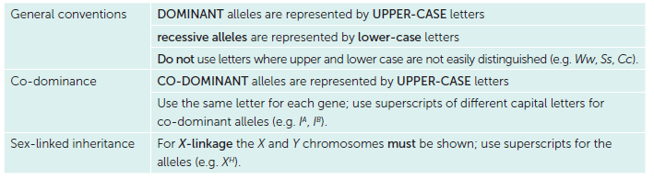
15.5 Other types of inheritance
The conventions used for representing alleles are outlined in the table.

Slide 33
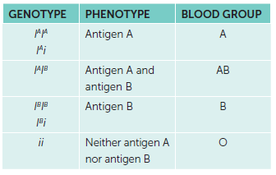
15.5 Other types of inheritance
Multiple alleles
Sometimes there are more than two alleles for a particular characteristic. In such cases, they are called multiple alleles and the position of that gene on a chromosome is called multiple allelic.
An example of multiple alleles is seen in the way ABO blood groups are inherited in humans. A person may belong to blood group A, group B, group AB or group O. Blood groups are inherited, and the ABO blood grouping system is based on the fact that an individual can possess any two of three alternative alleles: I^{A}, I^{B} or i.
Alleles I^{A} and I^{B} are co-dominant – that is, neither allele is dominant to the other and both characteristics occur in the heterozygote. The allele i is recessive to both I^{A} and I^{B}. Its effect is masked by the alleles I^{A} and I^{B}.

Slide 34
15.6 Genetic counselling
Concerned couples may seek additional information about the risk of inherited disorders occurring in their children.
Genetic counselling
One form of advice is genetic counselling. By examining the incidence of a disorder in the family tree, the probability that a particular condition will occur can sometimes be determined. The couple can then decide whether to risk having a baby with the inherited disorder.
For example, if a couple with no history of genetic disorders in either family had a child with an autosomal recessive condition such as thalassaemia, a genetic counsellor would tell them that there was a one-in-four chance of each of their subsequent children having thalassaemia.

Slide 35
15.6 Genetic counselling
Profiling techniques
Advances in biotechnology have resulted in the development of techniques to identify the unique genetic make-up of individuals. For some inherited conditions, this has enabled couples to know with more certainty the chances of having an affected baby.
A person’s DNA is so distinctive that it can be used as a means of identification. The technique of electrophoresis produces a banding pattern that is an individual’s DNA fingerprint, often called a DNA profile.
DNA fingerprints are useful in the identification of carriers for hereditary diseases. Using gel electrophoresis, a person who carries an allele that may cause a hereditary disease, such as cystic fibrosis or Huntington’s disease, can be identified, as can a newborn baby who will develop the disease.

Slide 36
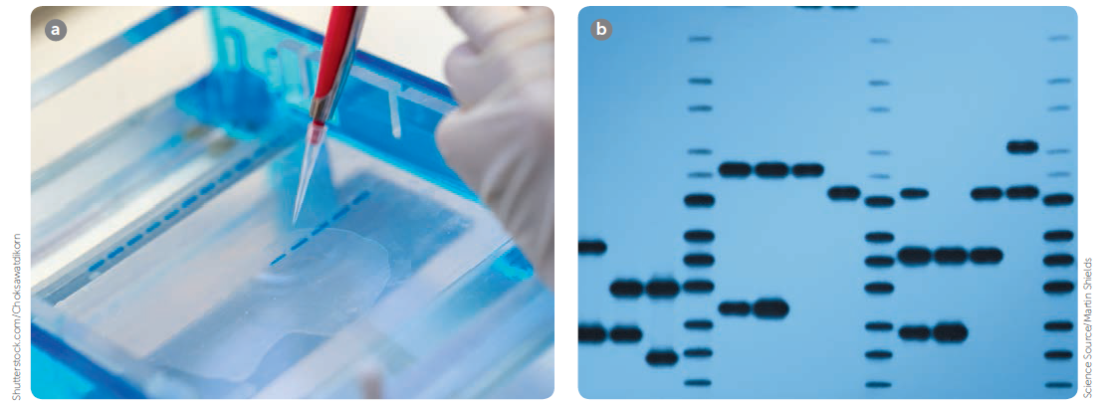
15.6 Genetic counselling
a Adding a DNA sample to the gel electrophoresis; b A DNA fingerprint

Slide 37
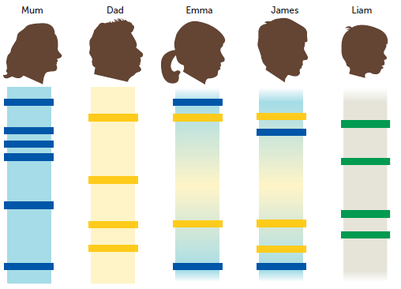
15.6 Genetic counselling
DNA profiling is also used in determining parentage. The DNA fingerprints of a family are shown. Emma and James are biological brother and sister. They do not have the same DNA profile but there are similarities. Each of them has some bands in their profiles that are the same as bands in each of their parents’ profiles. Yet, neither has DNA that is identical to one parent or the other. Liam is adopted. His DNA has no bands that are the same as his adoptive parents’.

Slide 38
15.6 Genetic counselling
In comparing DNA fingerprints, scientists use markers. A marker is a segment of DNA with known characteristics. These segments of DNA do not code for a protein, but they contain short sequences where the same pattern is repeated a number of times. Because the number of repeats in these sequences is inherited, they make useful points of comparison in genetic testing.
To determine a link between two individuals, specific markers on the DNA strand are studied. Scientists look for the number of repeats at each marker, examining between 20 and 40 markers. If 10 different markers on different chromosomes are examined, there is only a one in a million chance that two people will have the same number of repeats, except for identical twins. The more markers that match, the more likely it is that the two individuals are related.

Slide 39
15.6 Genetic counselling
Ethical and social issues
Genetic profiling and its applications raise many ethical and social issues. Some of these include:
Who does the statement of a person’s genome (complete set of genetic information) belong to? Who will be allowed access to the record, and what happens if it is stolen or misused?
In many cases when potential for disease is discovered, there is no way that development of the disease can be prevented and no treatment when the disease does develop. This may lead to unnecessary anxiety, and possibly stigma.
Genetic may yield little definitive information, or be unreliable due to environmental factors that modify the expression of a gene.
DNA profiling in determining parentage raises many ethical considerations, for example if a sample is obtained without the person’s knowledge, or a paternity test result in a father choosing not to continue raising a child they had thought was theirs prior to a DNA test.

